Slide 1
When And Where Do We Need Emergency Services?
Analysing Vic Roads crash data
August 2023
Andre Medina
Notes:
Thanks for the opportunity
Pretending youre in charge of emergency services
with the power to
redistribute ambulances and police car
where they are needed
Pretty sure that power is given to the goveremnt triple 0 related department
but generally that’s who im target
so now lets start
Hi im andre
today we are looking into the question
when and where do we need emergency services?
so first, lets look at the significance of this question

Slide 2
Why?
Make sure we have enough emergency services for the accidents that do occur
How many emergency services do we need?
Should we reallocate the current distribution?
Where should we send Ambulances & Police in the moment?
Notes:
so why?
why does this matter?
make sure we have enough emergency services
for the accdients that occur
we want to
Reduce the wait time
between a accdients and
services arriving
help the people involved
get to the hospital
if the need
and have police
keep the traffic to keep flowing
all as fast as possible
so some more specific questions would be
====click
how many emergency services do we need? do need 10 ambulances roaming around
or will only 1 cater the need
===click
should we reallocate the current distribution?
should we move Police from deerpark to saint Kilda
which areas need the most demand
===click
where should we send ambulances & police in the moment?
if several are dispatched to non-road related emergencies,
How many should we reallocate from other areas?
-----
These are all questions to help improve
the efficiency of the emergency services
to benefit the public the most
with the resources we have

Slide 3
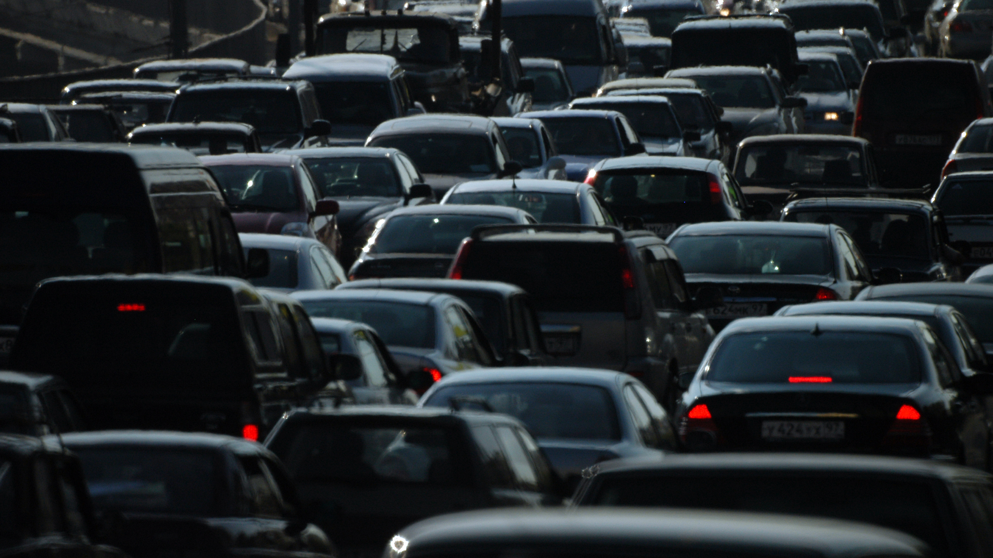
How?
The crash data!
Group the accidents
Count the times emergency services were required
Create a statistical model
Notes:
so how are we going to do this?
====click
with the crash data of course!
so the general goal
is to
====click
group the accidents
based on pre determined data
we will investigate this in a bit
====click
for each group,
count the times emergency services were required
then
====click
with that nicely formatted data
create a statistical model

Slide 4
Major Stages
Viewing initial trends
Further data cleaning
Final statistical model
Investigating structure & wrangling data
Analyzing results & recommendations
Notes:
So the major steps we will go through
-------
firstly
investigate the data structure
and wrangle the data
make sure we understand
what data we have access to
then we want to wrangle that data
get that data into a nice format
--------
with that nicer format
we can then
view the initial trends
to decide where we go next
--------
and maybe
might need to clean the data a bit more
so some further cleaning
-------
then with the fully clean data
we can create a statistical model
---
and with the model
we can analyse it
to get our final results
and talk about some recomendations

Slide 5

Investigating Structure & Wrangling Data
Notes:
3 mins
first and second Stage
investigating the strucute and
warngling the data
I grouped them together,
no too much to talk about
for either stage

Slide 6
Initial Data Structure
Pre-Accident data
Time of accident
Local Government Area (LGA)
Light condition
Atmospheric condition
Road condition
Post-Accident data
Severity
Number of people involved
Accident type
Police required
Ambulance required
Notes:
The initial data structure
the data is split into two general type
pre-accident data
information we have before the accidents
post-accident data
information we will have after the accidents
for the pre-accident data
===== click
we have features like
the date and time
location
if its bright or dark
atmospheric conditions (the weather)
road conditions (if the roads wet dry etc..)
we want to use these features
to predicted the outcome
as for post-accident data
==== click
included the
severity
number of people involved
accident type
if police were required
and if ambulance were required
so generally,
we don’t want to use this data
we shouldn’t predicted if an ambulance
was needed if we know how many people were involved

Slide 7
Simplifying Data
Pre-Accident data
Day of the week
Part of the day
Night 12am – 6am
Morning 6am – 12pm
Afternoon 12pm – 6pm
Evening 6pm – 12am
Atmospheric condition
Road condition
LGA / Region
Post-Accident data
Police required
Ambulance required
Notes:
as for which features we will use
sticking with the post-accidents data
we are trying to find
emergency service counts,
so police and ambulance required are a must
everything else we cant use
as previously stated
as For the pre-accident data
=== click
for the date and time
need to find
a middle between time group sizes
don’t want month long data groups
not useful for schedules
don’t want 1 minute intervals
don’t have the data
so I decided on splitting time
into days of the week
(Monday through Sunday)
===click
and days themselves into
part of the day
creating
--- read slide
=== click
using the atmospheric and road conditions
this encapsulkates the weather
we will look into this a bit more in a second
=== click
and for location
I chose to keep both
local government area
and region
for now
will investigate which is best soon

Slide 8

Ambulance Required
Only one ambulance per accident
Each person of an accident had their injury severity recorded
If someone was taken to the hospital, it was recorded
Notes:
Now Ambulances required
there wasn’t a direct stat for this
there was police required
which was either true or false
so I modelled ambulance required after that
===click
meaning a true or false per accident
only can be one ambulance or none
which is an assumption that had to be made
it is possible to predicted the number per accident,
but too intensive for our purposes
and there would be too many other assumptions made otherwise
as how to calculate if an ambulance was required
===click
each person of an accident had
their injury severity reported
if anyone had an injury that
was deemed to need medical attention
ambulance required was set true
==click
or if someone straight up
went to the hospital
it was recorded as an ambulance took them

Slide 9

Viewing Initial Trends
Notes:
6 mins
So now we have wrangled our initial data
we can do some basic analysis
but before going
even further in the process
we need to remove some variables
we have too many
so
time to look at some graphs!

Slide 10
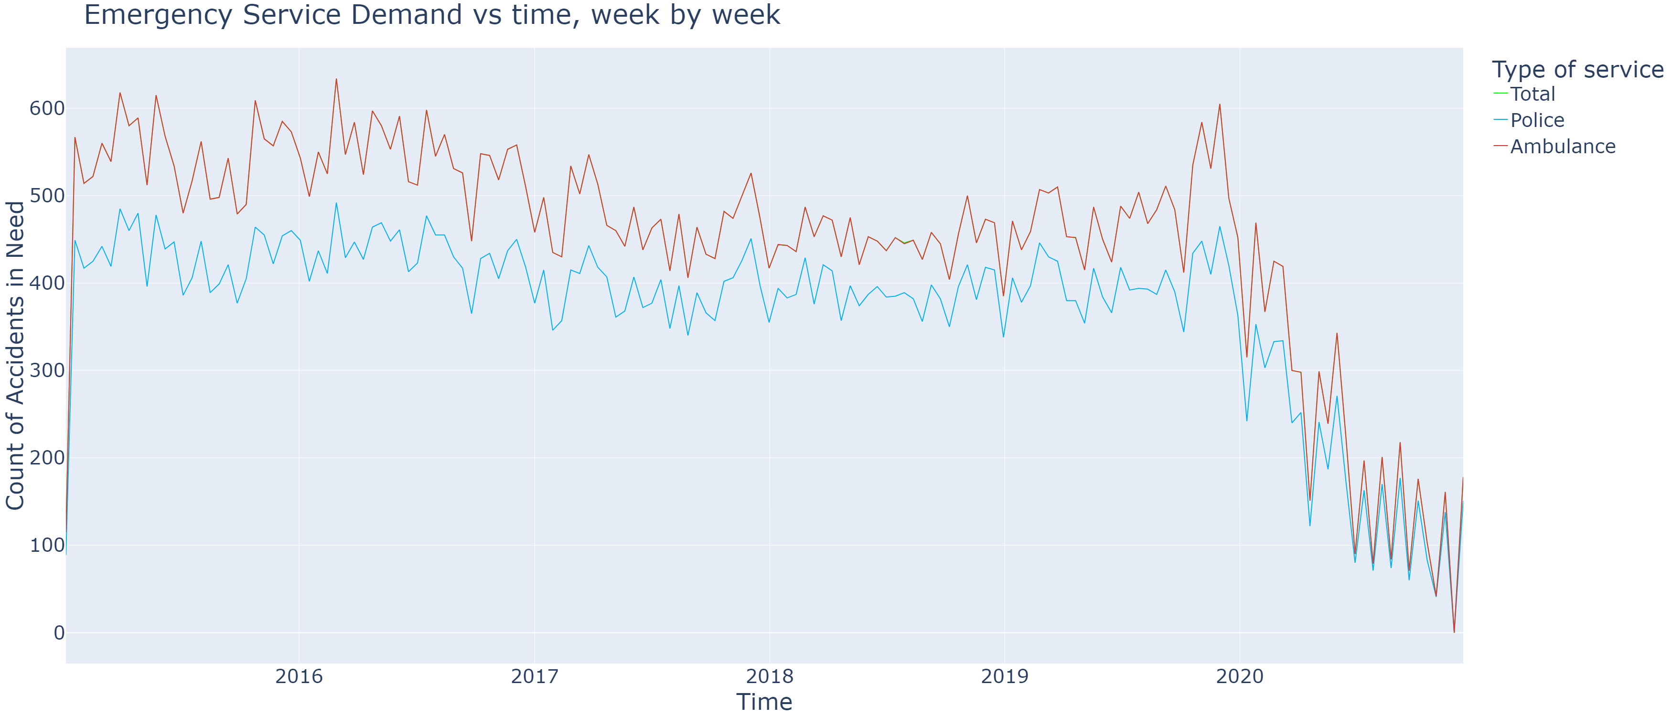
Emergency Callouts Over Time (Fortnightly)
Notes:
Frist off we have
Emergencies callouts over time
grouping fortnightly
red line is ambulance
blue line is police
firstly
note there is a
very High correlation between
Pollice and Ambulance counts
they end up being pretty much
proportional to each other
so are treated as such as we continue
if you take a look at the legned
there is also a green line
that’s the total accident count
which is under the ambulance data
sampling bias from the data
or assumptions we made
the total accidents = total ambulances
not considering this an issue
because assumptions were valid
if someone need medical attention,
there should be an ambulance
finally,
2020 onwards,
covid effect this data quite a bit,
and 2021 was the latest date
so only looking at pre covid data
so next stage

Slide 11
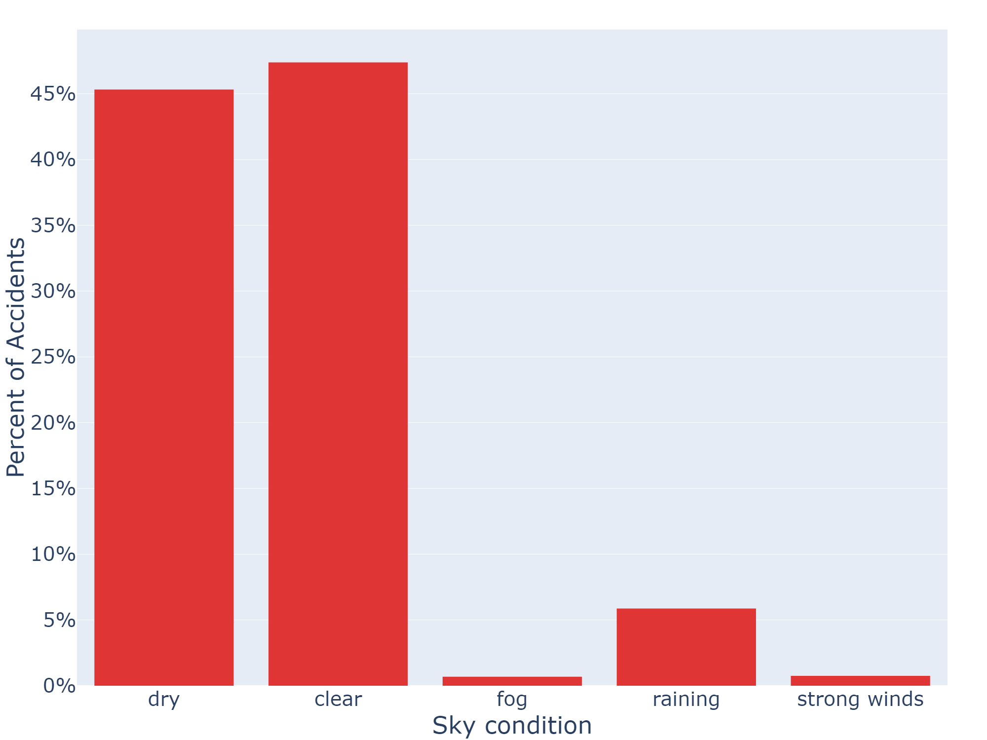
Accidents by Road and Sky Conditions
Notes:
acciendents by road and sky conditions
road and sky conditions were
already simplified in the wrangling step
due to low usage
we can futher notice fog and winds
don’t appear much
they are on the chopping block
we can also look
at the interaction between them
to see what we should get rid of

Slide 12
Correlation of Conditions
Notes:
to see correlation
we can use this correlation plot
pretty much
This shows the how strongly the conditions are related to eachother
red means highly correlated
blue is less correlated
dry vs clear
that’s expected
and they are both related
to rainging
also expected
because they are all so related,
we should only keep one
looking at clear
its more related to fog and wind than the others
so will only keep clear

Slide 13
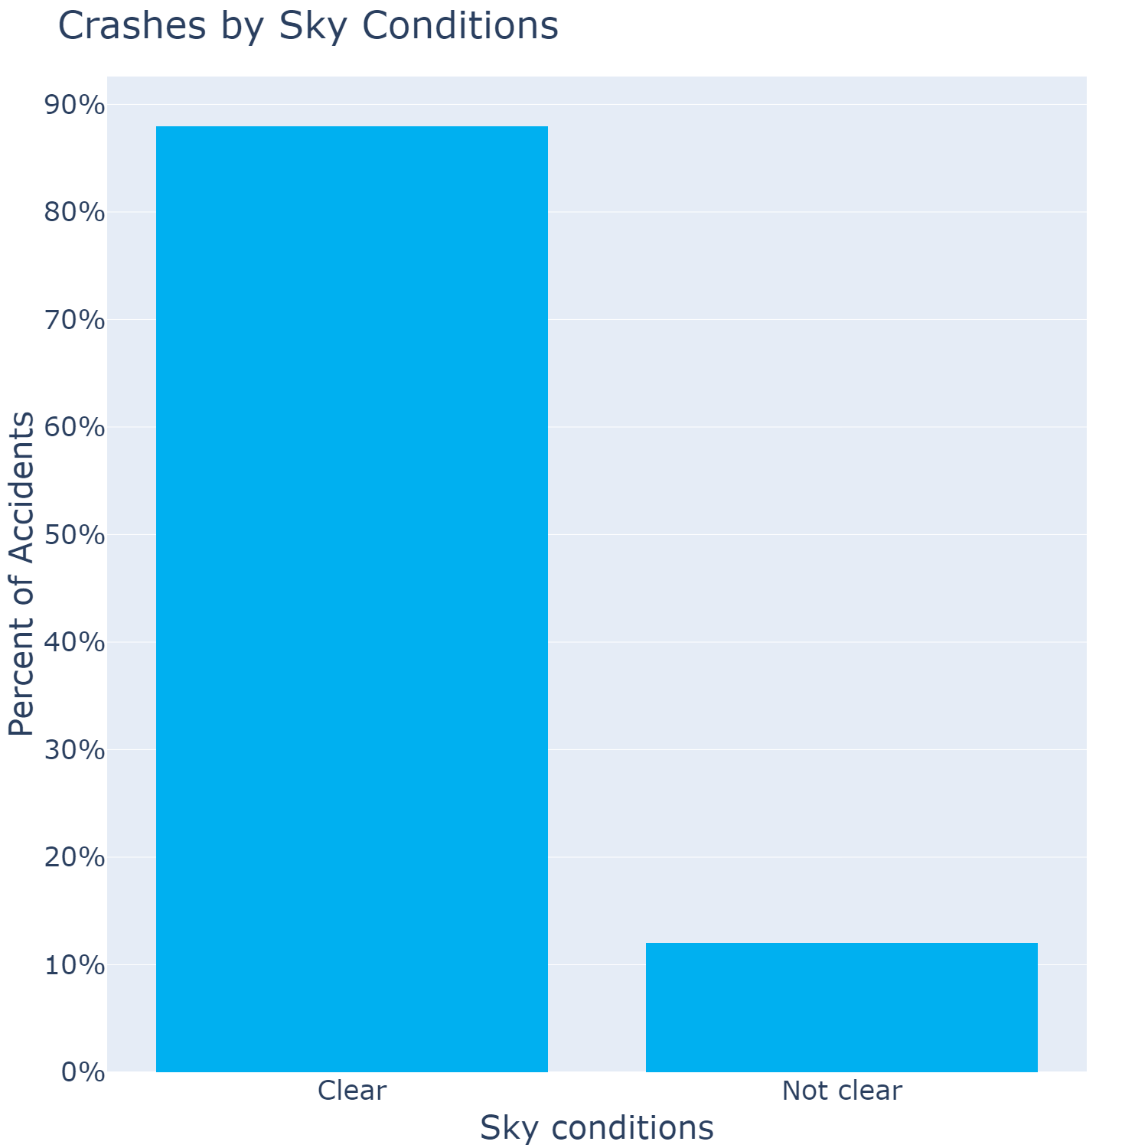
Emergency Callouts by Sky Conditions
Notes:
this simplifies the road and atmospheric conditions into one column
called ‘sky condition’
either, clear or not clear
- heres a graph showing that
Note:
looking at this graph
not clear is super low compared to clear
so do less accidents happen when its raining?
probably not, this is a
sampling bias
less non clear rainy days
than clear days
We will look into this issue a bit more later

Slide 14
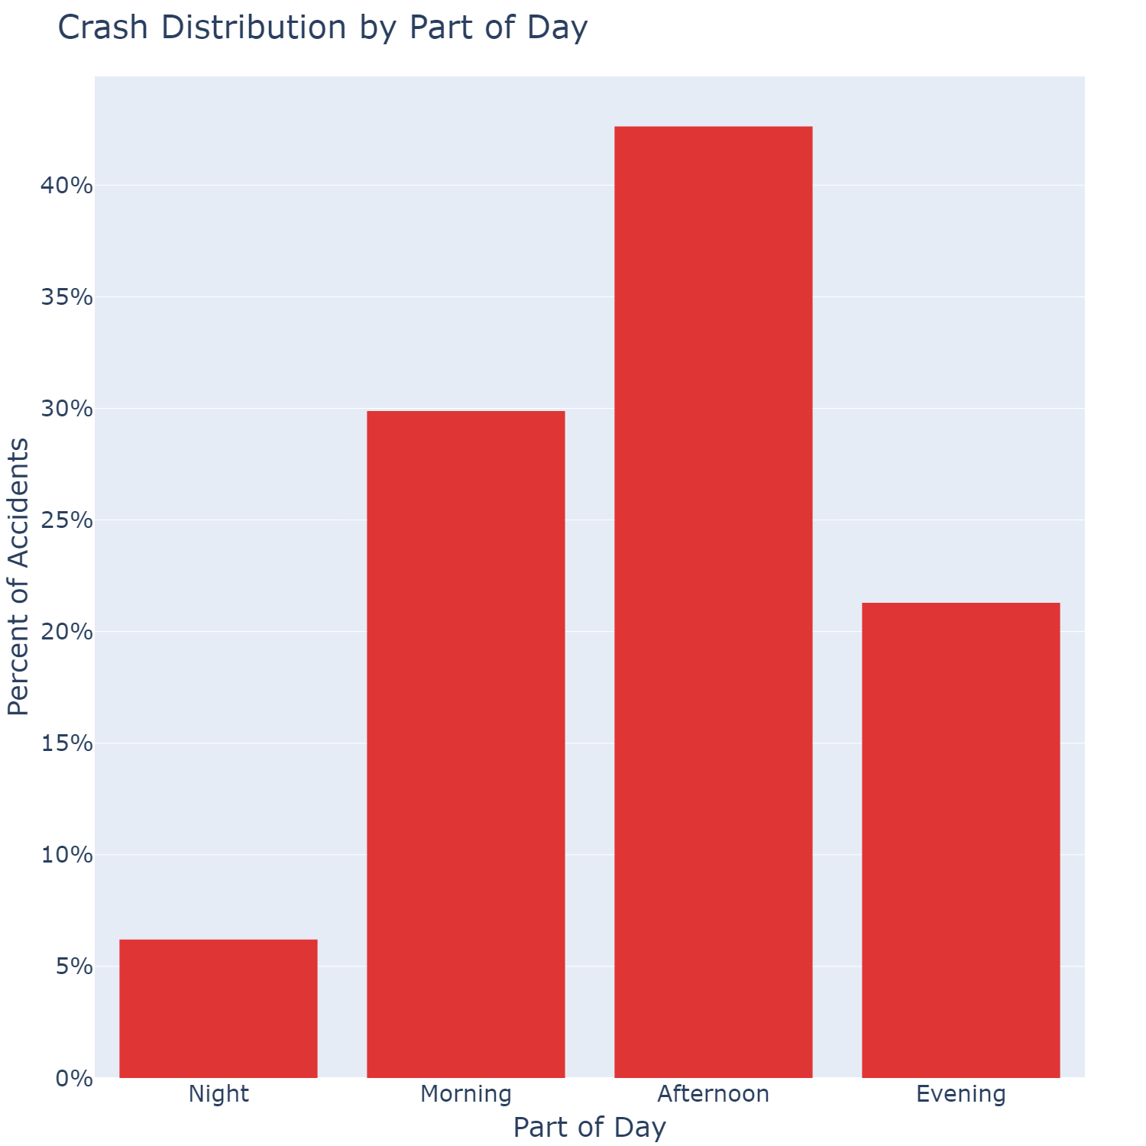
Accidents by Part of Day
Notes:
Moving onto time
here we have the accidents
across parts of the day
we can theres clear differences
as we move across
so theres some useful data
cant remove anything as we
would like to keep these time bins

Slide 15
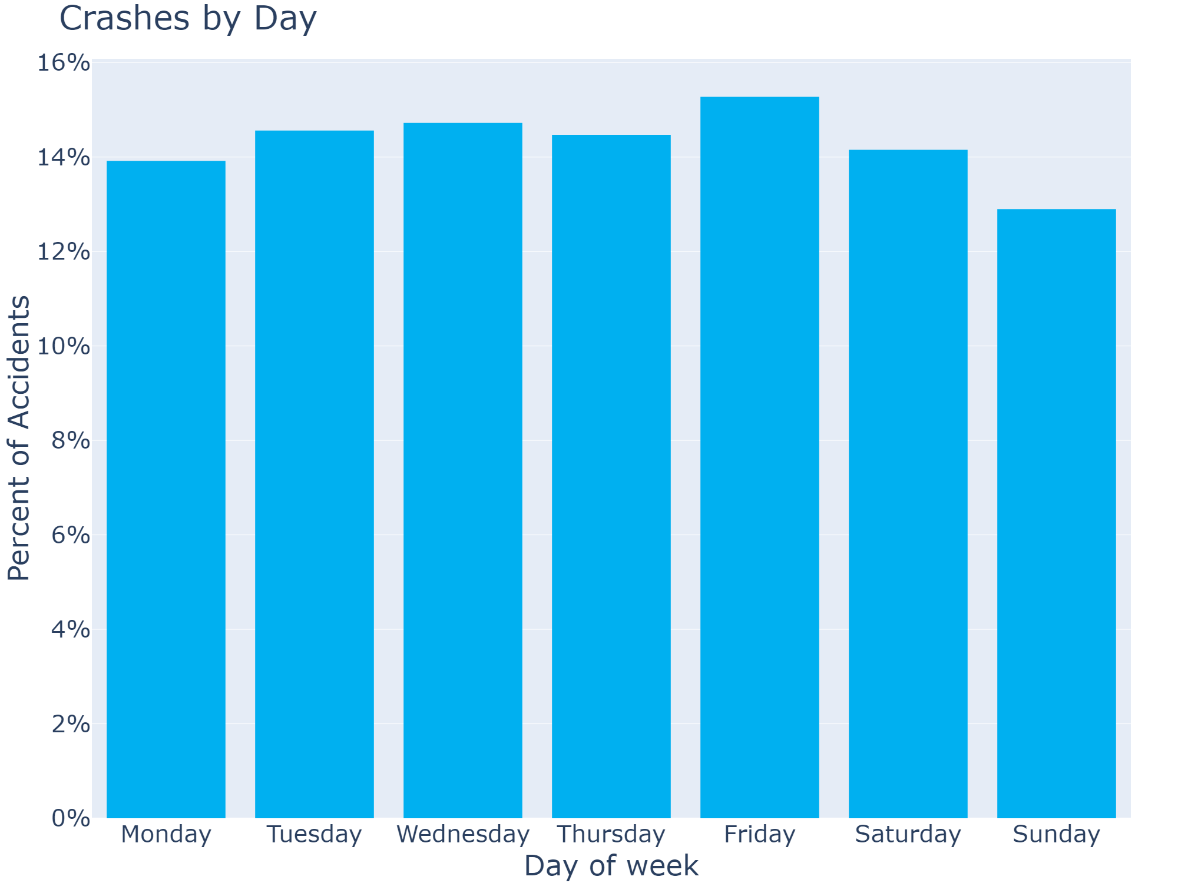
Accidents by the Day of the Week
Notes:
as for accidents across the week
looks pretty even
across every day
might think to
remove day of the week
due to lack of impact
however,
if we look at interaction
with other terms
we see a different story

Slide 16
Accidents by Day
Notes:
this is not a correlation matrix
This is showing
for each time of day
POINT
what day of the week
has most accidents
so there is clearly some interaction here
so we should not through out days of the week

Slide 17

Further Cleaning
Notes:
10 mins
Now we have some insights
time for a bit more cleaning
[youre on your own here]

Slide 18
Target Format
For each combination of
Sky condition
Region
Day of the week
Part of the day
Calculate average number of emergency services
Notes:
give example
clear Friday evening
in the northwest metropolitan melbourne
on avg you get 6 ambulances and 5 police
it’s a
raining Monday morning
in eastern regional vic
on avg you might get 1 an ambulance and 1 police

Slide 19
Potential Issues
Regional areas have smaller number of samples
Data is already split up into rainy days and clear days
Infrequent rainy days will skew data
Use probability of a rainy day to compensate
Data is both summated and averaged over time
Notes:
Potential issues
regional data is small
that’s fine, small pop -> less traffic and accidents
=== click (DON’T READ SLIDE)
data is already split up into
rainy days and clear days
so this ones a bit complicated
over a given year, each day is either clear or not
so theres is not a full spread of either each year
- explain rain with 100 days raining
so what we will do
we will extrapolate
each weather condition to cover
every day of the year
so scale by probability it will rain or be clear
- 100 days = 1/3 so multiple by 3
but you say
this assumes we have the pr it rains
well luckily
We have a data set is big enough
to give us a good weather distribution
we can
count number of days it rains vs
number of days its clear
(leaving only one accident each day)
then use those counts to estimate the probability
=== click
last issue is due to time
summating across a week
average over time
to accomplish this
summate everything
divide by the number of weeks

Slide 20
Cleaned Data Averaged Over Days
Not clear
Clear
Part of Day
Notes:
once we have done all that,
we have the final data
warning this is a
Busy graph,
its hard to display this data nicely
== click
this shows a sclice of the final data format
averaged over days of the week
some low values
0.10, ambulace is only called 1 in 10 times
some high values
- 4.99, 5 ambulances are called on average

Slide 21

Final Statistical Model
Notes:
14 min
Now we have our final data
time to produce the statistical model

Slide 22
Model of choice: Gamma General Linear Model (GLM)
Statistical model allows for prediction and understanding inner workings
Helps us achieve out goal
Good for continuous data
Good for data between 0 and infinity
Notes:
So why did I chose this model
first
I chose General linear model
because it
allows better insights into the inner workings
for more statistical outcomes
not just prediction and classification
like a deep learning model, which might be more accurate
this will help achieve our goal
of knowing where and when
to send emergency responders
with some basic reasoning
== click
as for why
a gamma distribution
simply
that data structure suits a gamma distributions
continuous data
between 0 and infinity

Slide 23
Training Testing Split
Training data
2015 – 2018
Testing data
2019
Notes:
- even tho it’s a GLM
- still splitting data
because
we still want to test its predictions
on fresh data
as for how I am splitting the data
=== click
READ SLIDE

Slide 24
Distribution of Features
Notes:
another busy graph warning
=== clickl
technical graph I know,
shoes the distibutions of ambulance count for each variable individually
come back later if you want
main thing is these box plots have a lot of outliers
except for the region data
- however region data here is probably due to my little brother and his friends, they quite careless, so watch out for them
interaction
look at interaction next

Slide 25
Interaction of Features
Notes:
Another busy technical visual
we can come back to this later as well
pretty much,
the bottom three graphs show
interaction between
day of the week, part of day and sky
with region
shows there’s not much interaction
however the top
shows interaction with the other terms
clearly there is interaction
eg
crossing of lines in
top right

Slide 26

Model Formula Gamma GLM
Response: Average number of emergency services
Region
Day of the Week
Part of Day
Sky condition
2-way interaction between
Day of the Week
Part of Day
Sky condition
Notes:
now for the the formula
Response variable
either avg num of
police or amblunace
====click
as for the design variables
….
====click
And interaction
…
Started with 2-way interaction
on all terms
I used back selection and AIC different times
generally
removed terms with interaction with region
kept other interaction
supports what we saw in the graphs before

Slide 27
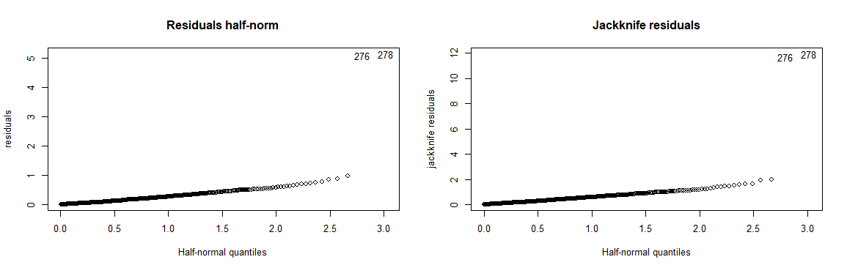
Uh oh! outliers!
Notes:
Quick model,
notice some outliers
nothing special
removed them

Slide 28
Model Diagnostic Plots
Notes:
====1 & 2
residual and Jackknife half normal graphs are straight
==== 3
residuals vs fitted is spread nicely
tiny bit of heteroscedasticty
but that’s fine
==== 4
cooks distance doesn’t have any jumps
all good, fit is solid

Slide 29
Results!
Notes:
18 min

Slide 30
Predicting Police Demand
Training Data
Testing Data
Notes:
first is police
Left is training
right is testing
bottom is true values
on the side is predicted
the black line is the goal
want all the dots on the black line
------
futher it goes out the larger the error
tried to compensate for this
with boosting instances with larger police numbers
but it didn’t help fit
little bit of overfitting
------
judging accuracy with
RMSE
this means
on average the number of police cars
the model is off by
RMSE
training = 0.2652675
testing = 0.5131998

Slide 31
Predicting Ambulance Demand
Training Data
Testing Data
Notes:
Same set of graphs for ambulances
very similar results
RMSE
Training = 0.3426021
Testing = 0.62
but predictions aren’t why we chose the statistical model
if we wanted predictions
I easily made a basic deep learning model
which got way better RMSE
so why did we chose a statistical model?

Slide 32
Statistical Analysis and Results
Metropolitan areas have a greater chance of needing an ambulance
Regional areas has a slightly decreased risk
Evenings and nights decreases risk
Except Friday and Saturday evenings*
Weekly mornings increased risk
Not much to do with Mondays
raining?
Weather being ‘not clear’ in the evening increased risk significantly
Whereas raining in the morning has a decreased risk
Raining itself wasn’t significant
p-values < 0.001
*p-values < 0.05
Notes:
we chose it for the analytic abilities
all these stats are
with very high certainty
===== click
for statistically minded
p score of less than .1%
===== click
metropolitain areas greatly increase the chance of need an ambulance
whereas regional areas had a slightly decreased risk
===== click
evenings and nights generally decreases
=== click
but firday and sat nights increased the risk
=== click
mornings incrased chance,
===== click
surprisingly monday morning didnt do much
==== click
‘not clear’ weather in the evening increased risk quite a bit
==== click
Where as ‘not clear’ weather in the morning decreased risk
===== click
However
raining itself was inconclusive if it increase the risk

Slide 33
Use cases for the model
Ad campaigns about the statistical results
Alert system to redistribute in the moment
Compare current distributions with predictions
Further modelling
Focus on the smaller Local Government Areas
Notes:
so what about some use cases for the model?
=== click
Ad campaigns about the statistical results
best first step
we could help inform and caution
drives about dangerous groupings
preventing accidents from happening
in the first place
==== click
create an alert system
based on the predictions
to redistribute emergency services
in the moment
so if an area had an
expected need of 10 ambulances
but only had 2 roaming
and another areas had extra ambulances
shuffle them around
to accommodate the potential need
==== click
or even just
compare current emergency service
distribution with what is expected
and finally
==== click
we could use the ideas of this model
and create futther models
possibly focusing on the LGA for more precision

Slide 34
When and Where Do We Need Emergency Services?
Non clear Friday evenings (6pm – 12am) in
southeast and northwest metropolitan Melbourne
That’s tonight! (if it was raining)
Northwest:
between 5.25 and 7.5 ambulances
between 4.5 and 6.5 police
Southeast:
between 5.75 and 8 ambulances
between 5 and 7 police
Take care on the drive home!
Notes:
however,
To answer the initial question
just sampling a couple points
the model correctly predicted the top two
most needed groupings for emergency services
as being the top two
which were
=== click
Non clear Friday evenings
in metropolitan northwest and southeast
=== click
lines up with tonight
the model
predicted
==== click
in the North west,
an average of
between 5.25 and 7.5 ambulances
and
between 4.5 and 6.5 police
however
True data from 2019 avearged
8 abulances and 6 police
=== click
and for the south east,
an average of
between 5.75 and 8 ambulances
and
between 5 and 7 police
and again
True data from 2019 avearged
8.5 abulances and 7 police
=== click
so please take care on the drive home!
and get some ambulances around
-------

Slide 35

Thanks for your time
Questions?
Notes:
27 mins (taking notes throughout)
23 mins
22 mins

